Slide 1


Federated Visualization: A Privacy-preserving Strategy for Aggregated Visual Query
Wei Chen¹, Yating Wei¹, Zhiyong Wang¹, Shuyue Zhou¹,
Bingru Lin¹, Zhiguang Zhou²
1: State Key Lab of CAD&CG, Zhejiang University
2: Hangzhou Dianzi University
Notes:
Hello, everyone.
I’m Jiehui Zhou from Zhejiang university
This work is the joint work with Hangzhou Dianzi University

Slide 2






Introduction
Location 1
Location 2
Location 3
Location 4
Notes:
In big data era, a large amount of data are being generated all the time and scattered over different data holders.
It is a significant task to closely connect data holders and conduct collaborative data analysis for deeper insights and comprehensive conclusions.

Slide 3



Introduction
Motivation
Data-intensive visualization
+
easily aggregate and
analyze the datasets
Distributed visualization
-
a great risk of privacy
leakage
inference
Information
Notes:
In visualization community, two kinds of methods are commonly used for collaborative data analysis including data-intensive visualization and distributed visualization.
(点击) In data-intensive mode, raw datasets are directly assembled, processed and visualized in a main server.
(点击) In distributed mode, datasets and tasks are divided into pieces over various clients, and required information can be transmitted among clients.
(点击) In the both modes, users can easily aggregate and analyze the datasets at different stages.
(点击) However, there is a great risk of privacy leakage in the entire course of data processing.
(点击)for example, In the distributed mode, users can reversely infer the data information of a client through additional data information. it is urgent to provide a feasible multi-source data visualization method without privacy leakage.

Slide 4
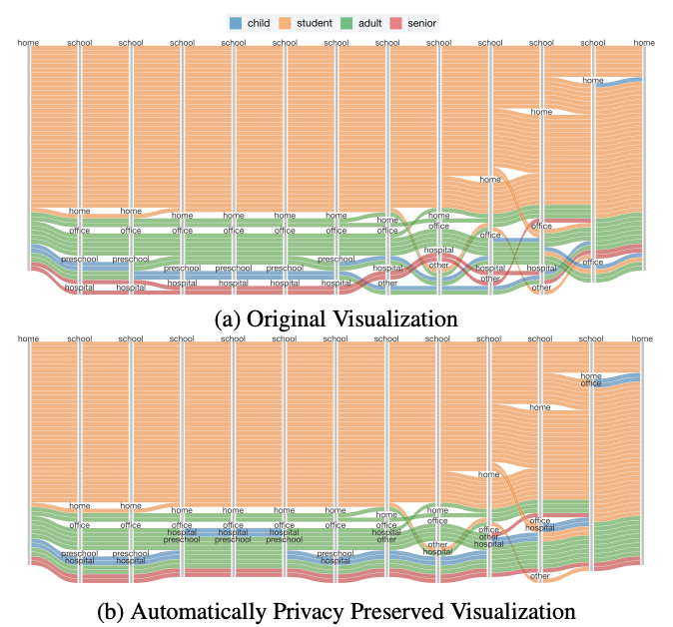
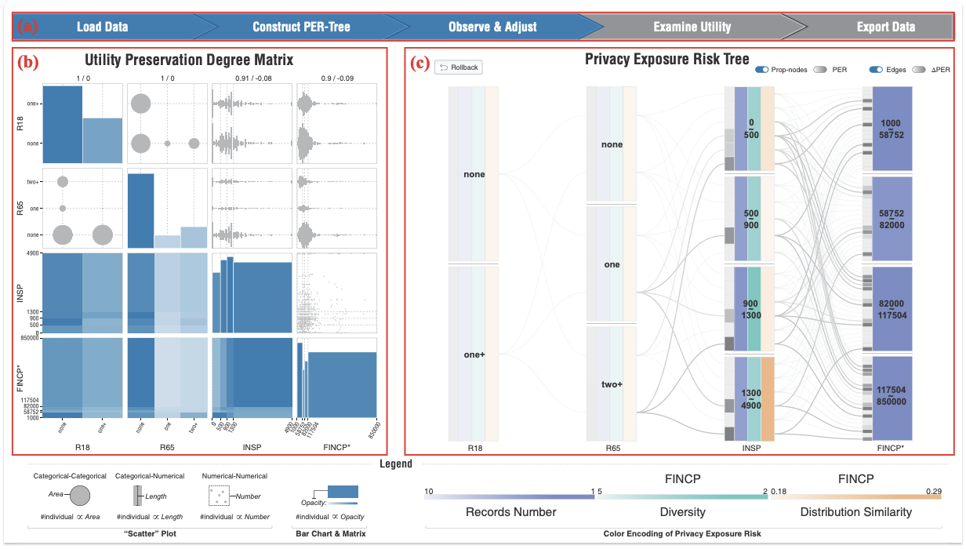
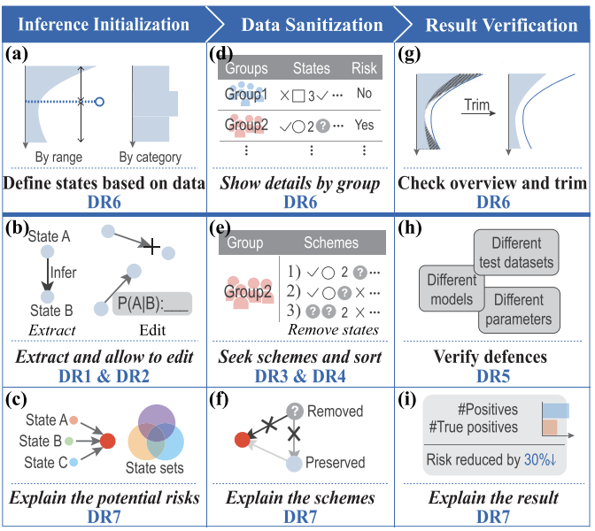
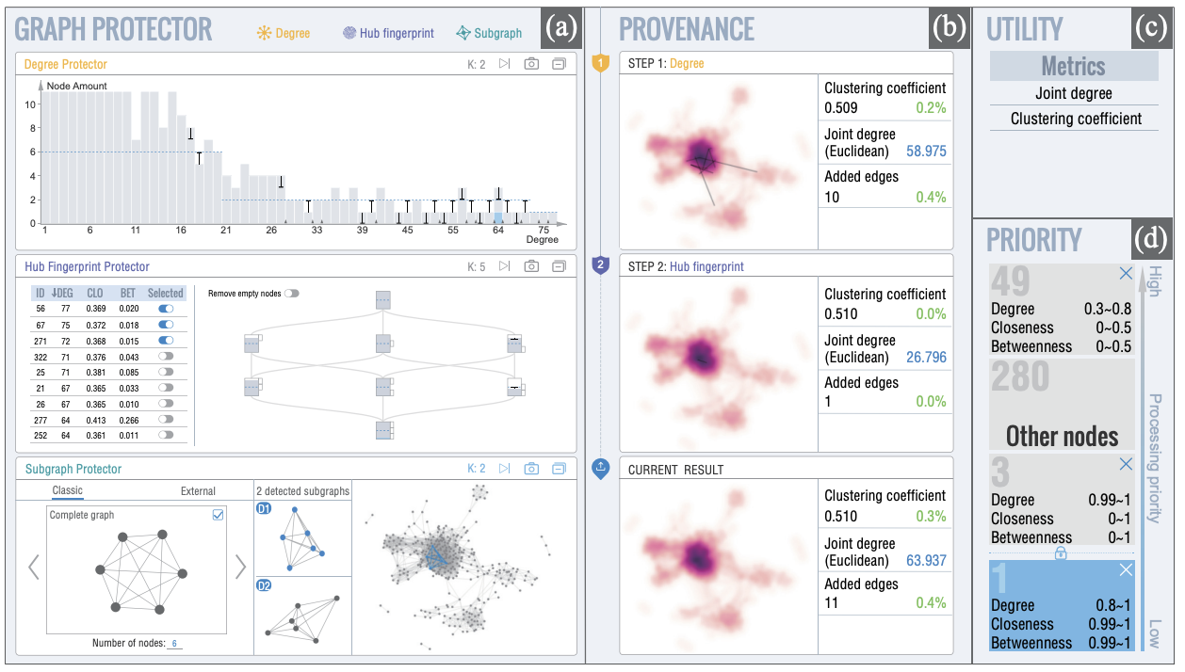
Introduction
Motivation
+
protect data leakage within a centralized visualization process
Sankey Diagram-like Representation
Jia-Kai Chou et al., 2016
A Utility-aware Visual Approach
Xumeng Wang et al., 2017
-
incorporate data encryption in visualization steps
-
keep data locally
-
evaluation of decentralized visualization
Umbra
Xumeng Wang et al., 2022
GraphProtector
Xumeng Wang et al., 2018
Notes:
privacy-aware visualization has been explored in the visualization community
（点击）existing works emphasize on protecting data leakage within a centralized visualization process
（点击）There are still a few challenges for tackling privacy issue in the decentralized visualization：
- A conventional visualization pipeline consists of multiple steps, including data processing, transformation, visual mapping, and user interaction. Data leakage can take place in each step in decentralized mode. Data encryption should be thoroughly incorporated as a necessary component.
- For the reason of privacy protection, data in local modules should be kept locally, and only desensitized information can be transmitted to the global module.
- finally, It is important to evaluate the validity and usability of decentralized visualization in the protection of privacy and collective analysis based on multisource datasets.

Slide 5
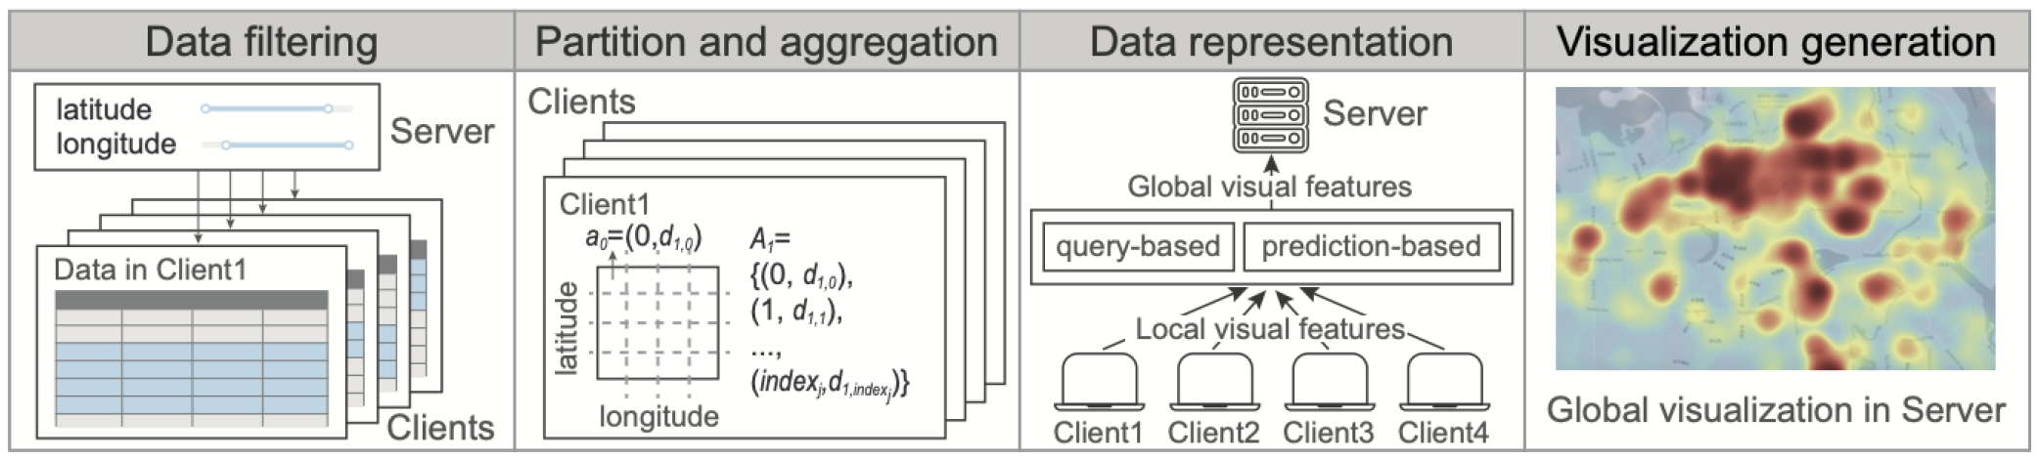
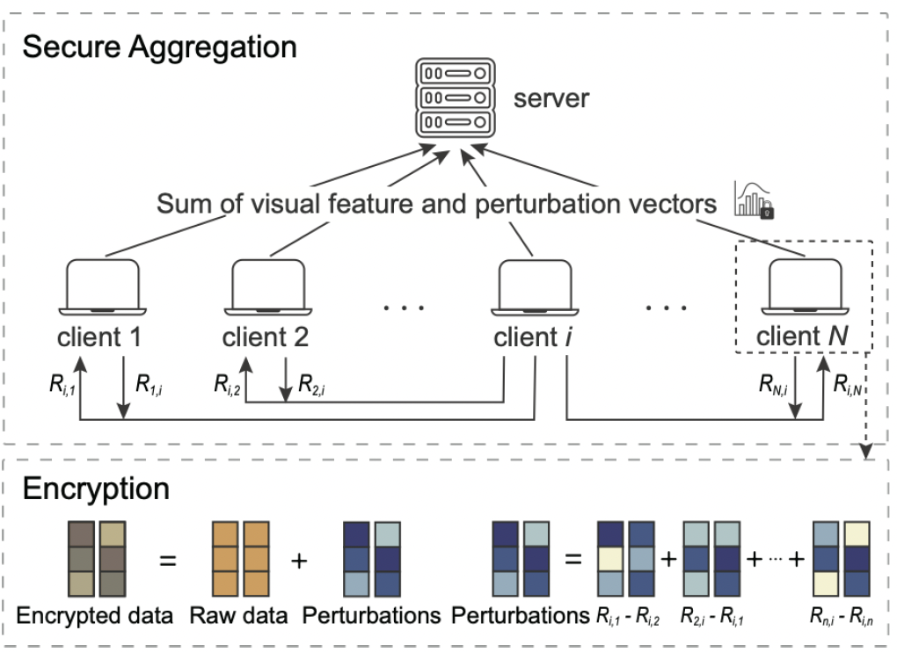
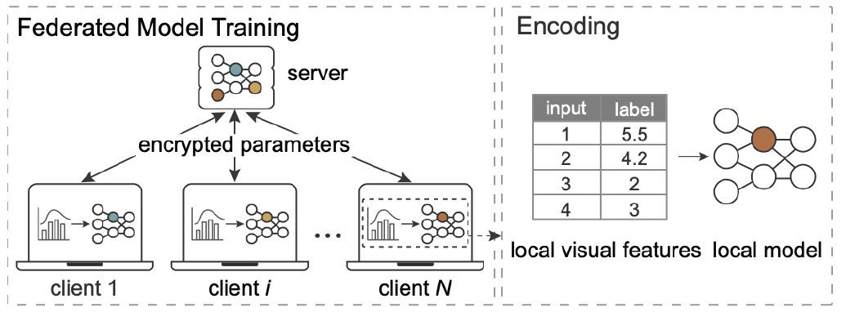
Introduction
Contribution
1
a novel federated
visualization framework
2
two implementation
schemes
evaluation and verification based on real world data
3
Notes:
So we present a novel federated visualization framework for visualizing aggregated visual query of decentralized data.
and propose two implementation schemes for different data analysis scenarios. They are integrated into the proposed framework.
At last, we evaluate and verify our framework based on real world data. Experiments and cases demonstrate that effective visual analysis can be conducted while preserving privacy.

Slide 6
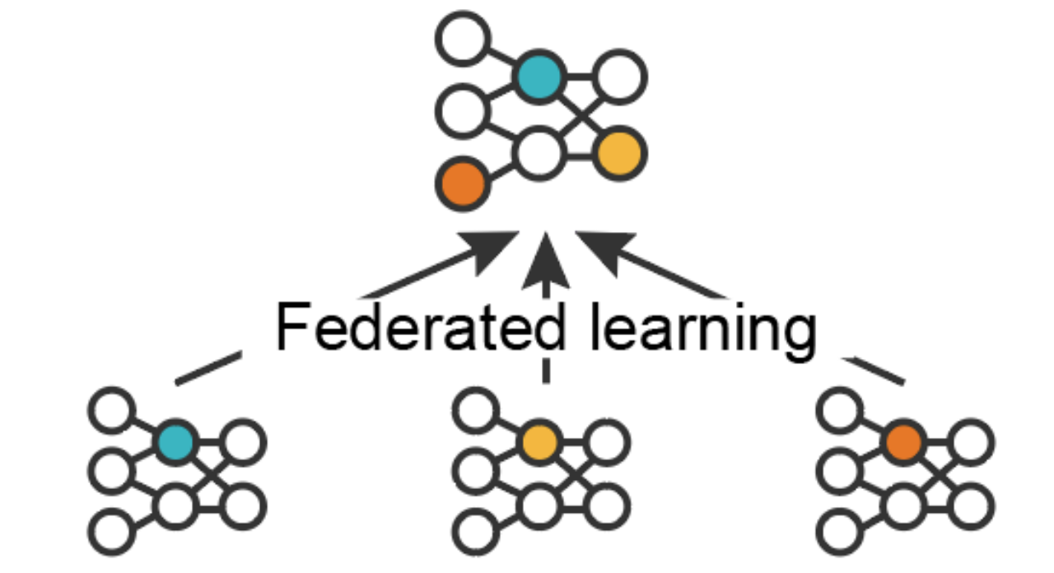
Our Approach
How to tackle privacy issue in the decentralized visualization?
employ a shared global model
run local model in individual clients
use a variety of encryption schemes
Notes:
Next we introduce our approach
First we need to think about a question：How to tackle privacy issue in the decentralized visualization?
In the field of data mining, facing the challenges of data privacy in distributed machine learning,
federated learning employs a shared global model to federate the learned local models that run only in individual clients,
and uses a variety of encryption schemes in the data transmission process.

Slide 7
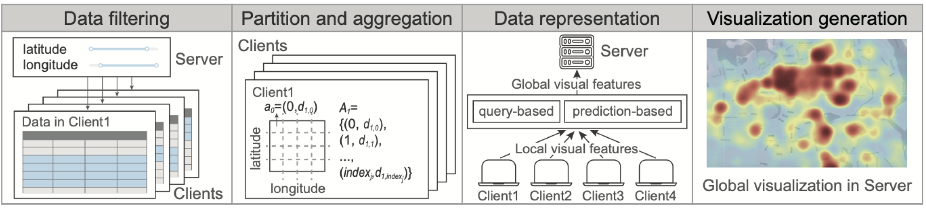
Our Approach
How to tackle privacy issue in the decentralized visualization?
In local clients
divide the tasks of data transformation and visual mapping into pieces
In a server
compose the secured results
Notes:
Inspired by the idea of federating learned features rather than raw data, we design a federated aggregation visualization strategy.
We divide the tasks of data transformation and visual mapping into pieces in local clients,
each client locally performs data transformations and visual encodings with its associated data.
Then we compose encrypted visual features or parameters in a server, or to say a shared global module.
(点击) The pipeline for federated visualization consists of four main stages.

Slide 8
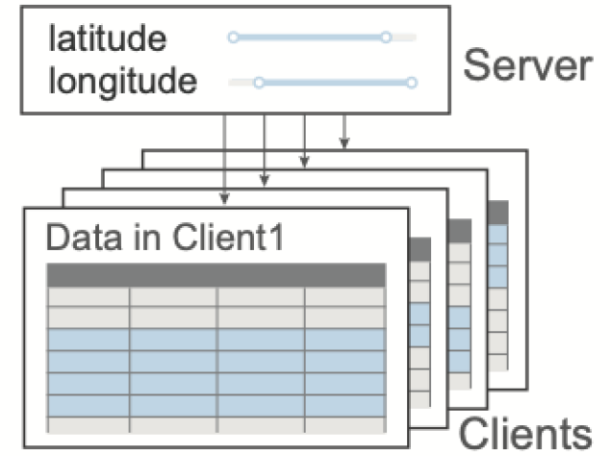
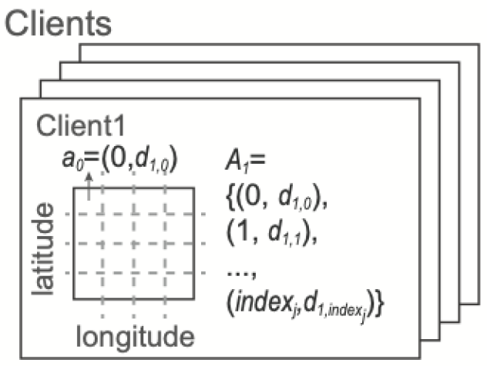
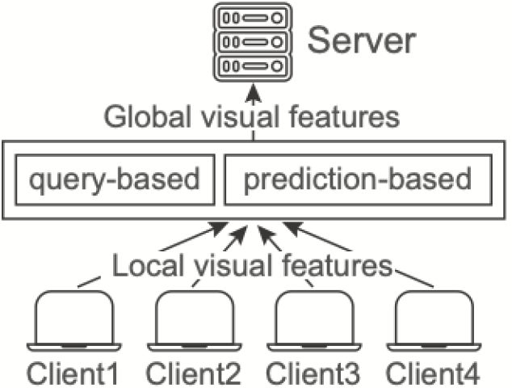
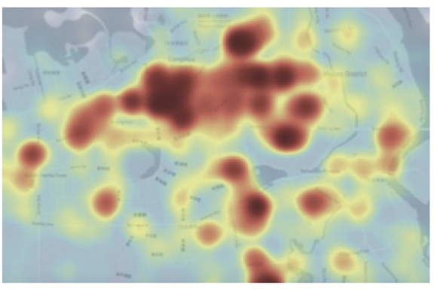
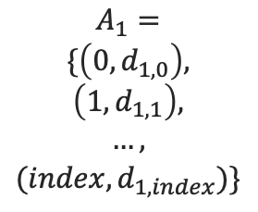
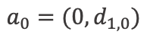
Our Approach
Pipeline for federated visualization
Data filtering
Partition and aggregation
Data representation
Visualization generation
index | feature value
index | feature value
index | feature value
index | feature value
Laplacian
noise
index | feature value
$$a_{0}=(0,d_{1,0})$$
$$A_{1}=$$
$$\{\left(0,d_{1,0}\right),$$
$$\left(1,d_{1,1}\right),$$
$$…,$$
$$(index,d_{1,index})\}$$
index | feature value
decode
encode and encrypt
Notes:
（data filtering）First, data in a specific latitude and longitude range is specified by analysts, each client conduct data filtering locally
(点击)
（partition and aggregation）
（点）For each client, its data is partitioned into small pieces uniformly. The resolution of the partition can be predefined or interactively specified subject to the employed visual forms. For instance, creating a heatmap requires dividing the data over a 2D grid.
（点）Then, data aggregation is performed over each binned range of the partition. （点）The aggregated values are mapped into visual features, forming a visual feature set Ai. Each element aj of Ai is a key-value pair. Here, indexj denotes the index, and d is the feature values of indexj. （点）This process is performed on each client, resulting in visual features with identical dimensions.
(点击)
(data representation)
This process requires analysts to encode and encrypt visual features in each client and utilize them in the server.
(点击)
(visualization generation)
Based on the encrypted visual features from local clients, the server composes a set of global visual features and generates a visualization. This process provides an additional layer of privacy preservation for the generated visualization in to prevent attackers from re-identifying small sample size data via the visualization.

Slide 9
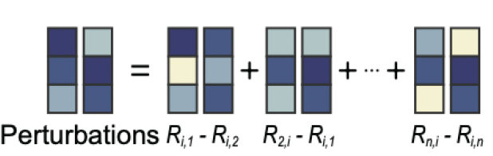
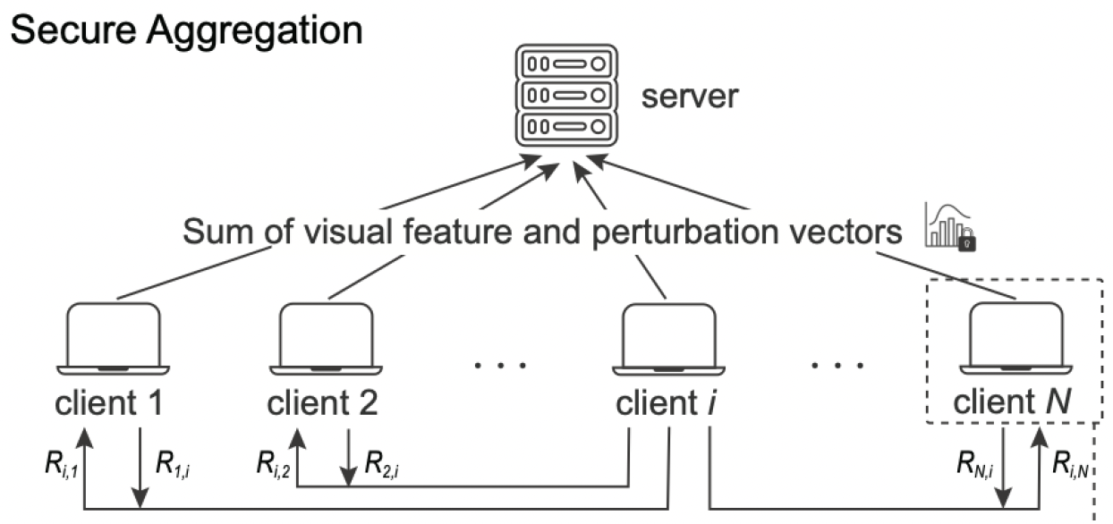
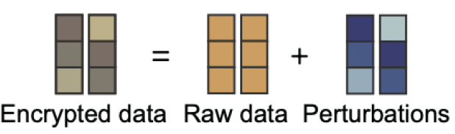
Our Approach
The query-based scheme
Encode local visual features using secure aggregation techniques
1. sampling random vectors
2. exchanging random vectors and computing perturbations
3. computing global visual features in the server
Notes:
Next we go into the schemes for the third stage. it is crucial that the visual features of each client are not exposed during the transmission process.
The Query-based scheme encodes local visual features using secure aggregation techniques.
The first step is Sampling random vectors, Each pair of clients first prepares a random vector for each other. Specifically, Ri, j and Rj,i are a one-to-one pair.
The third step is Computing global visual features in the server. The server receives the perturbed vectors uploaded by clients, and sums them. The sum is guaranteed to be accurate visual features because the paired perturbations in upload data are neutralized. And the values of each client will not be inferred.

Slide 10
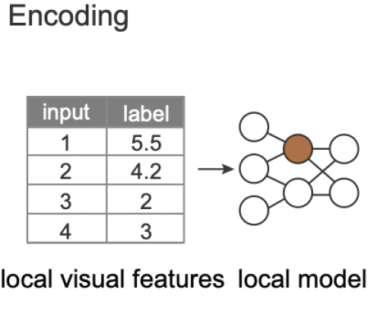
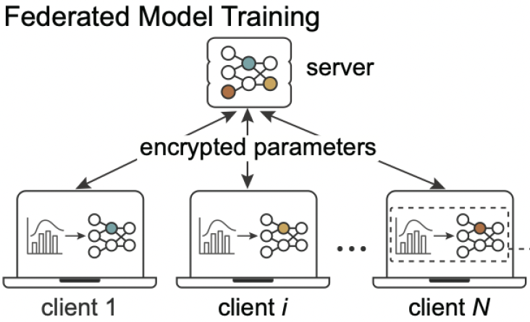
Our Approach
The prediction-based scheme
Encode visual features by precomputing a representation
a fully connected deep network
Mimic the federated learning framework
Notes:
The prediction-based scheme encodes visual features by precomputing a representation with a fully connected deep network, and mimic the federated learning framework where all clients contribute to training a shared global model that represents global data features.
(点击)First, each client converts visual features into a training dataset and sends parameters of the local model to the server.
（点击）Then, the server performs a federated averaging over the set of encrypted parameters from all clients to obtain a global model.
The global model contains encrypted visual features for all clients.
These visual features can be easily restored from the model, and be used to generate the visualization.

Slide 11
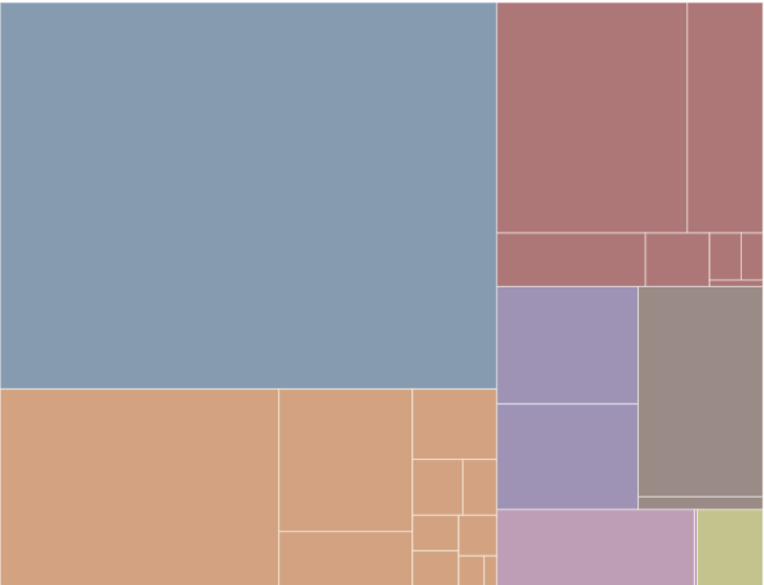
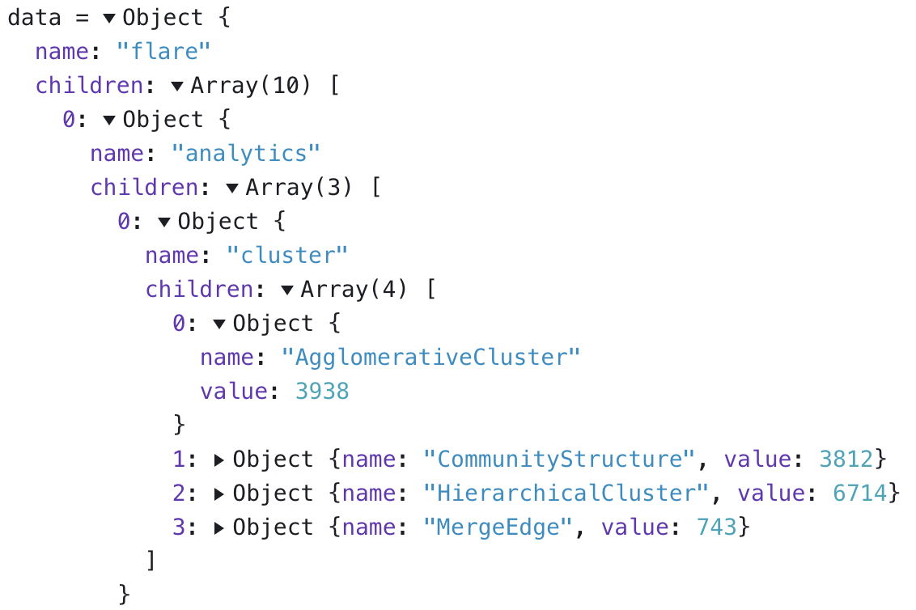
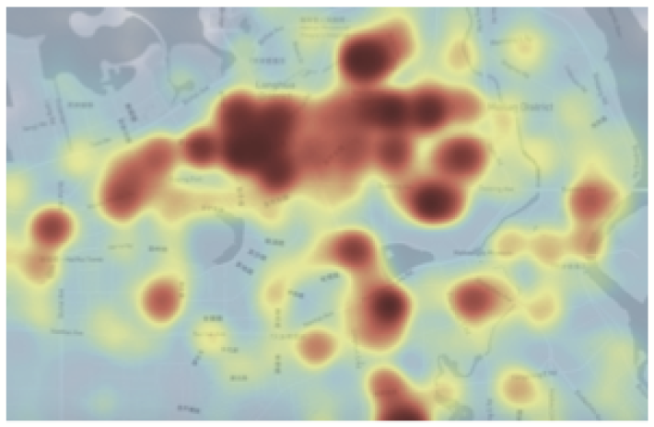
Federated chart generation
Structured tabular data
Hierarchical data
15960 (190×84) grids
https://observablehq.com/@d3/zoomable-treemap
Notes:
Below, we show the creation of a variety of aggregation-based visualizations, ranging from structured tabular data to hierarchical datasets.
（点击）The heatmap in the Figure consists of 15960 (190×84) grids divided by uniform longitude and latitude. Each grid cell has an index and a value. The accumulated density in each grid cell is encoded by hue, which represents the number of records in the corresponding geographic area. On each client, a heatmap is calculated based on local data. Those heatmaps, reflecting the distributions of datasets on each client, have the same cell index. Our goal is to get an overall heatmap that reflects the distribution of all clients’ datasets without leaking privacy.
（点击）The data structure of hierarchical data is more complex than that of tabular data. Without loss of generality, the tree structures of all clients are assumed to be identical. For example, in the case of aggregating street sign-in information from various regions of the country from different clients, the hierarchy of the geographic locations of the clients is the same.
（点）Thus, each client merely needs to count the numbers of leaf nodes and provide their encryption key in order to craft a treemap, after which the server can summarize and present the treemap.

Slide 12
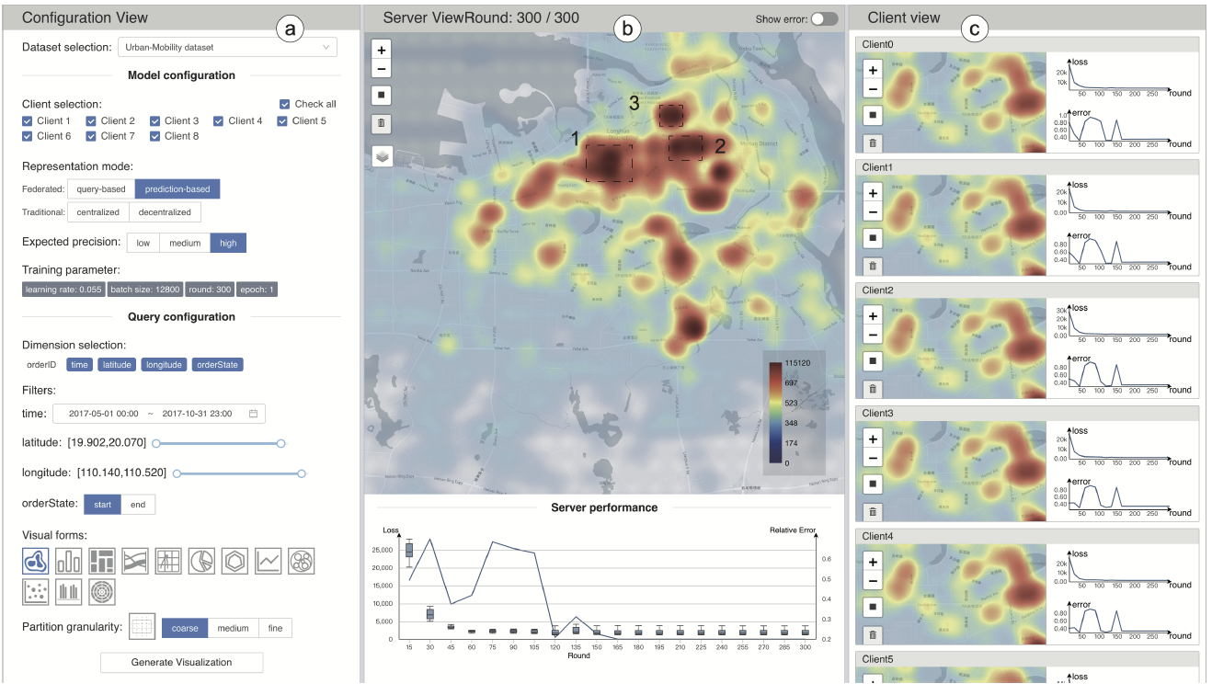
Evaluation
prototype system
Source code: https://github.com/ZeroWangZY/fed-vis
Notes:
We implement a web-based prototype system. And the source code of our system is available.

Slide 13
Evaluation
Quantitative evaluation
performance
accuracy
error chart
Notes:
The quantitative evaluation compares our two schemes with the centralized counterpart with three measures: performance, accuracy, and error chart.

Slide 14
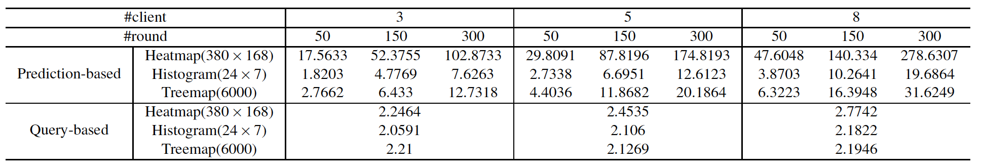

Evaluation
Quantitative evaluation: performance
Difference between federated visualization and traditional visualization
Query-based scheme: data encryption
Prediction-based scheme: model training
Notes:
The difference between federated visualization and traditional visualization methods lies in the data representation phase.
Extra time for the query-based scheme is spent on data encryption, while the time overhead for the prediction-based scheme lies in model training.
（点）Thus the query-based scheme has relative short response time than the prediction-based scheme. The prediction-based scheme can be inefficient when the parameter number of the prediction model is large, i.e., more than ten thousands.

Slide 15
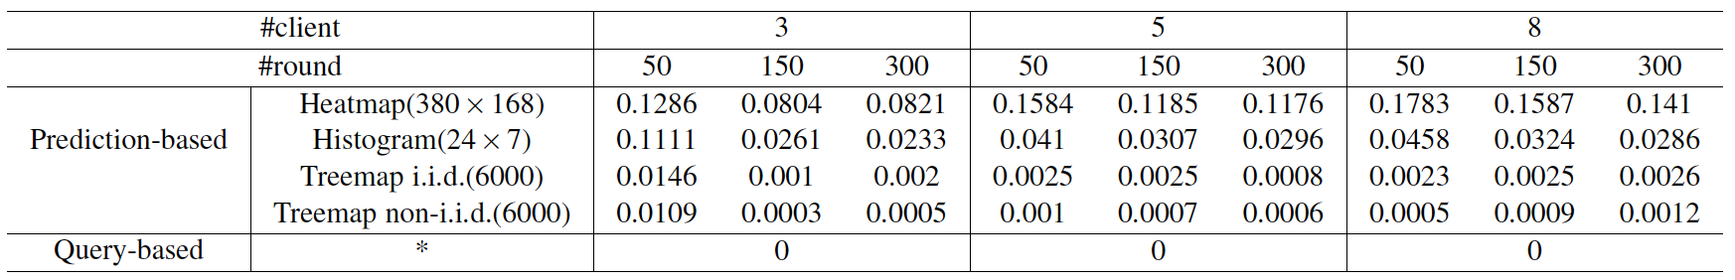
Evaluation
Quantitative evaluation: accuracy
Query-based scheme:
a small amount of Laplacian noise
Prediction-based scheme:
approximately generated visual features
Notes:
With the query-based scheme, a small amount of Laplacian noise has been added to the queried visual features, and the results are still relatively accurate.
In contrast, errors occur with the prediction-based scheme because visual features are approximately generated.

Slide 16
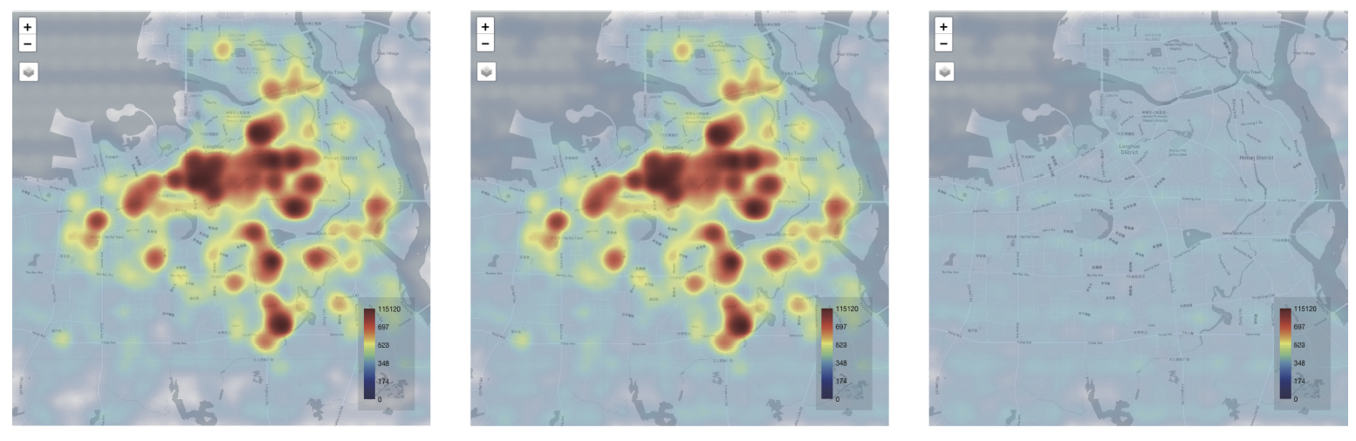
Evaluation
Quantitative evaluation: error chart
the predicted result
the exact result
the difference map
Notes:
The figure shows the error chart. It indicates little difference between the result with the prediction-based scheme and the exact result. Both outcomes are visually identical.

Slide 17

Evaluation
Case study
1. The United States
Cancer Statistics dataset
2. Urban data exploration
3. The MovieLens dataset
enable aggregated visual queries
support various visual forms
choose schemes according to data
missed attribute value
query-based prediction-based
In the future…
integrate more schemes into our
framework
Notes:
We conduct case studies on three real world datasets. We describe how our framework enables users to achieve aggregated visual queries and use various visual forms for visual analysis while protecting data privacy.
We explained how to choose schemes in different situation. The prediction-based scheme has better generality than the query-based scheme.
In addition, we can design more schemes and integrate them into our framework for more analysis scenarios.

Slide 18
Discussion
Privacy preservation
Secure aggregation guarantee privacy under threat conditions
server is honest-but-curious
server can lie to client
Collusion among clients can result in privacy leakage
expose the data of the innocent client
Notes:
At last, I’d like to discuss the privacy preservation of our work.
Secure aggregation is widely used in federated learning to encrypt the model gradients of each client and avoid backtracking the original data. Secure aggregation can guarantee privacy under the threat conditions of server is honest-but-curious and server can lie to client, that is, all clients follow the protocol honestly, but the server may try to learn additional information in different ways.
However, collusion among clients can result in privacy leakage. Our approach employs secure aggregation to protect the privacy of transported parameters. In our implementation, if four of the five clients collude with each other, the four clients send invalid information to the server, such as zero. Consequently, the composed visualization only shows the data of the innocent client, which may lead to privacy exposure.

Slide 19
Summary
Contribution
1
a novel federated
visualization framework
2
two implementation
schemes
evaluation and verification based on real world data
3
Notes:
In summary, our work addresses an important aspect of decentralized visualization: privacy. The fundamental idea is to mimic the process of federated learning, and reformulate the visualization process with a new federated model. We propose two implementations: a query-based scheme, and a prediction-based scheme.

Slide 20






Thank you!
Wei Chen, Yating Wei, Zhiyong Wang, Shuyue Zhou, Bingru Lin, Zhiguang Zhou
This work is supported by:
The National Natural Science Foundation of China (No. 62132017, 62277013).
The Fundamental Research Funds for the Central Universities under Grant 226-2022-00235.
Notes:
That’s all, thank you!

